Slide 1
Restoration and development of Arm's Java-based LEGv8 ISA simulator
Graduating student - Simone Deiana
Supervisor - Alberto Carini
Department of Engineering and Architecture
Trieste, 28 August 2024

Slide 2
INTRODUCTION
Restoration and development of
Arm's Java-based LEGv8 ISA simulator​

Slide 3
INTRODUCTION
Restoration and development of
Arm's Java-based LEGv8 ISA simulator​

Slide 4
INTRODUCTION
Restoration and development of
Arm's Java-based LEGv8 ISA simulator​

Slide 5
WHAT IS LEGv8?
Restoration and development of
Arm's Java-based LEGv8 ISA simulator​

Slide 6



WHAT IS LEGv8?
AN ISA FOR LEARNING COMPUTER ARCHITECTURES
David A. Patterson
Peg Skorpinski, CC BY-SA 3.0 <https://creativecommons.org/licenses/by-sa/3.0>, via Wikimedia Commons
John L. Hennessy
Eric Chan, CC BY 2.0 <https://creativecommons.org/licenses/by/2.0>, via Wikimedia Commons
From Computer Organization and Design ARM Edition: The Hardware Software Interface - Patterson, D.A. and Hennessy, J.L.

Slide 7
WHAT IS LEGv8?
As simple as it can be...
… but with a modern design
Heavily inspired by ARMv8, almost a "subset"

Slide 8
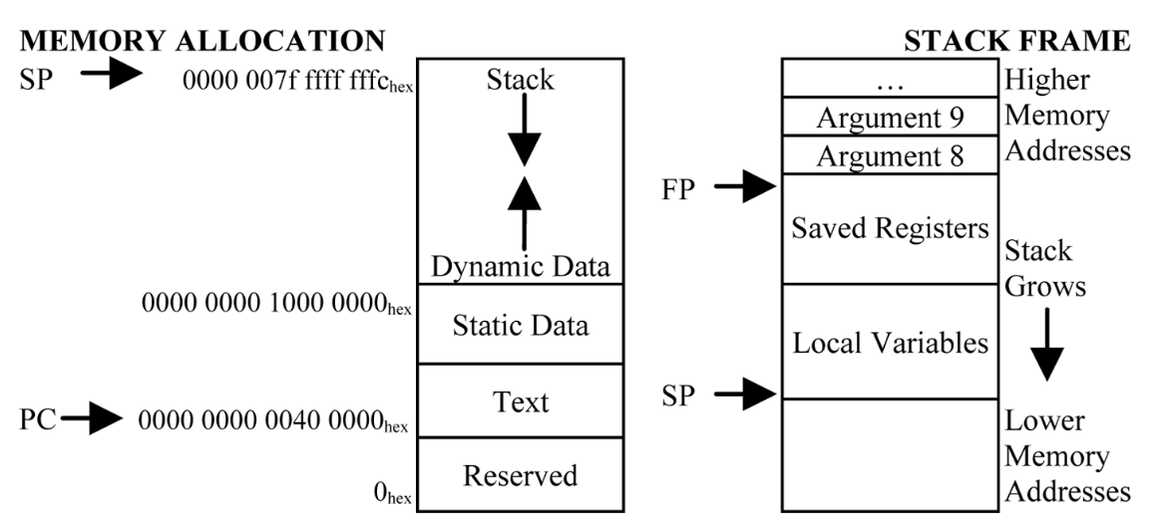
WHAT IS LEGv8?
64-BIT addressed memory, Harvard model

Slide 9
WHAT IS LEGv8?
32 64-bit "X" integer registers
32 64-bit "D" floating-point registers
32 32-bit "S" floating-point "registers"
64-bit integer and IEEE-754 floating-point arithmetic
Designed and optimized for pipelined execution

Slide 10
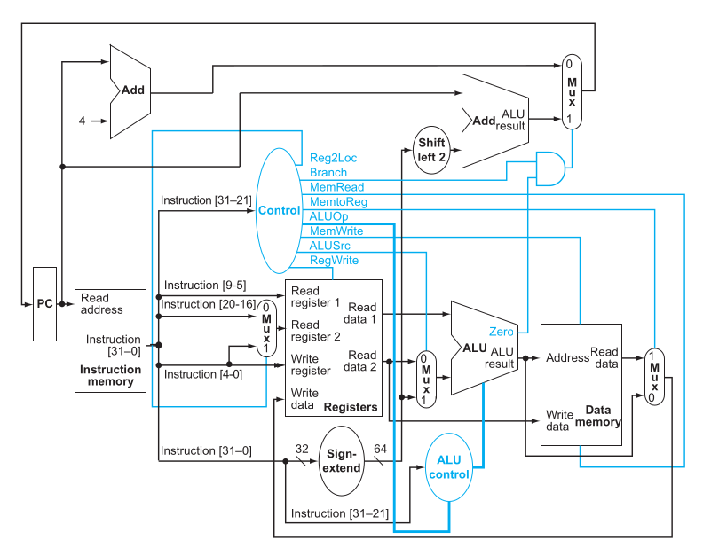
WHAT IS LEGv8?
THE DATAPATH
From Computer Organization and Design ARM Edition: The Hardware Software Interface - Patterson, D.A. and Hennessy, J.L.

Slide 11
WHAT IS LEGv8?
THE DATAPAH
INSTRUCTION MEMORY
From Computer Organization and Design ARM Edition: The Hardware Software Interface - Patterson, D.A. and Hennessy, J.L.

Slide 12
WHAT IS LEGv8?
THE DATAPATH
REGISTERS AND CONTROL UNIT
From Computer Organization and Design ARM Edition: The Hardware Software Interface - Patterson, D.A. and Hennessy, J.L.

Slide 13
WHAT IS LEGv8?
THE DATAPATH
ALU
From Computer Organization and Design ARM Edition: The Hardware Software Interface - Patterson, D.A. and Hennessy, J.L.

Slide 14
WHAT IS LEGv8?
THE DATAPATH
DATA MEMORY
From Computer Organization and Design ARM Edition: The Hardware Software Interface - Patterson, D.A. and Hennessy, J.L.

Slide 15
WHAT IS LEGv8?
THE STAGES
FETCH
From Computer Organization and Design ARM Edition: The Hardware Software Interface - Patterson, D.A. and Hennessy, J.L.

Slide 16
WHAT IS LEGv8?
THE STAGES
DECODE
From Computer Organization and Design ARM Edition: The Hardware Software Interface - Patterson, D.A. and Hennessy, J.L.

Slide 17
WHAT IS LEGv8?
THE STAGES
EXECUTE
From Computer Organization and Design ARM Edition: The Hardware Software Interface - Patterson, D.A. and Hennessy, J.L.

Slide 18
WHAT IS LEGv8?
THE STAGES
MEMORY ACCESS
From Computer Organization and Design ARM Edition: The Hardware Software Interface - Patterson, D.A. and Hennessy, J.L.

Slide 19
WHAT IS LEGv8?
THE STAGES
WRITE BACK
From Computer Organization and Design ARM Edition: The Hardware Software Interface - Patterson, D.A. and Hennessy, J.L.

Slide 20
WHAT IS LEGv8?
THE SINGLE CYCLE DATAPATH
FETCH
DECODE
WRITE BACK
EXECUTE
MEMORY ACCESS
INSTRUCTION 1

Slide 21
WHAT IS LEGv8?
THE SINGLE CYCLE DATAPATH
FETCH
DECODE
WRITE BACK
EXECUTE
MEMORY ACCESS
INSTRUCTION 1

Slide 22
WHAT IS LEGv8?
THE SINGLE CYCLE DATAPATH
FETCH
DECODE
WRITE BACK
EXECUTE
MEMORY ACCESS
INSTRUCTION 1

Slide 23
WHAT IS LEGv8?
THE SINGLE CYCLE DATAPATH
FETCH
DECODE
WRITE BACK
EXECUTE
MEMORY ACCESS
INSTRUCTION 1

Slide 24
WHAT IS LEGv8?
THE SINGLE CYCLE DATAPATH
FETCH
DECODE
WRITE BACK
EXECUTE
MEMORY ACCESS
INSTRUCTION 1

Slide 25
WHAT IS LEGv8?
THE SINGLE CYCLE DATAPATH
FETCH
DECODE
WRITE BACK
EXECUTE
MEMORY ACCESS
INSTRUCTION 2

Slide 26
WHAT IS LEGv8?
THE SINGLE CYCLE DATAPATH
FETCH
DECODE
WRITE BACK
EXECUTE
MEMORY ACCESS
INSTRUCTION 2

Slide 27
WHAT IS LEGv8?
THE SINGLE CYCLE DATAPATH
FETCH
DECODE
WRITE BACK
EXECUTE
MEMORY ACCESS
INSTRUCTION 2

Slide 28
WHAT IS LEGv8?
THE SINGLE CYCLE DATAPATH
FETCH
DECODE
WRITE BACK
EXECUTE
MEMORY ACCESS
INSTRUCTION 2

Slide 29
WHAT IS LEGv8?
THE SINGLE CYCLE DATAPATH
FETCH
DECODE
WRITE BACK
EXECUTE
MEMORY ACCESS
INSTRUCTION 2

Slide 30
WHAT IS LEGv8?
THE PIPELINED DATAPATH
FETCH
DECODE
WRITE BACK
EXECUTE
MEMORY ACCESS
INSTRUCTION 1

Slide 31
WHAT IS LEGv8?
THE PIPELINED DATAPATH
FETCH
DECODE
WRITE BACK
EXECUTE
MEMORY ACCESS
INSTRUCTION 2
INSTRUCTION 1

Slide 32
WHAT IS LEGv8?
THE PIPELINED DATAPATH
FETCH
DECODE
WRITE BACK
EXECUTE
MEMORY ACCESS
INSTRUCTION 3
INSTRUCTION 2
INSTRUCTION 1

Slide 33
WHAT IS LEGv8?
THE PIPELINED DATAPATH
FETCH
DECODE
WRITE BACK
EXECUTE
MEMORY ACCESS
INSTRUCTION 3
INSTRUCTION 2
INSTRUCTION 1

Slide 34
WHAT IS LEGv8?
THE PIPELINED DATAPATH
FETCH
DECODE
WRITE BACK
EXECUTE
MEMORY ACCESS
INSTRUCTION 3
INSTRUCTION 2
INSTRUCTION 1

Slide 35
WHAT IS LEGv8?
THE PIPELINED DATAPATH
FETCH
DECODE
WRITE BACK
EXECUTE
MEMORY ACCESS
INSTRUCTION 3
INSTRUCTION 2

Slide 36
WHAT IS LEGv8?
THE PIPELINED DATAPATH
FETCH
DECODE
WRITE BACK
EXECUTE
MEMORY ACCESS
INSTRUCTION 3

Slide 37
WHAT SIMULATOR, AND WHY?
Restoration and development of
Arm's Java-based LEGv8 ISA simulator

Slide 38

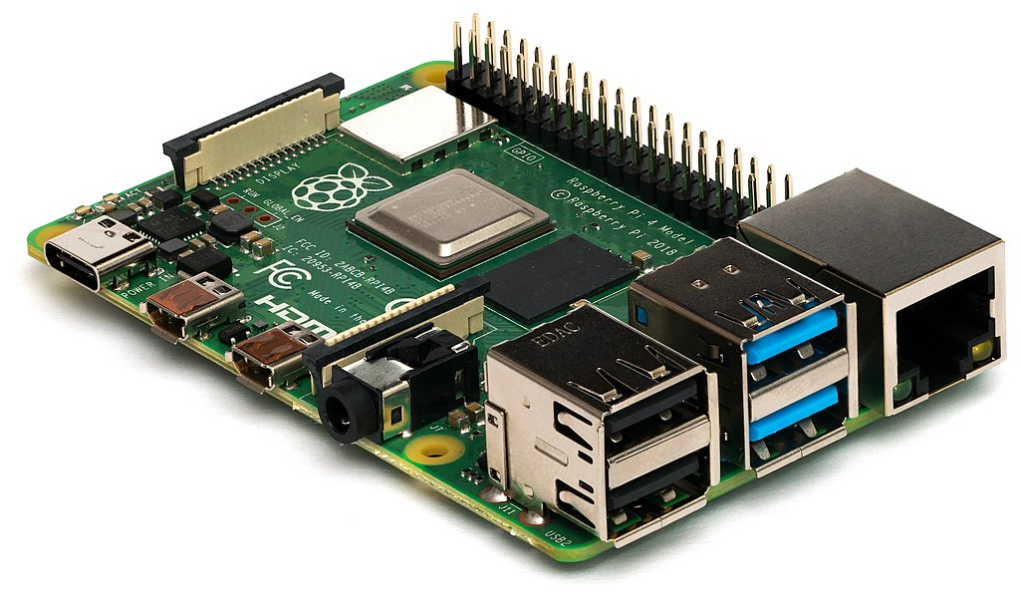
WHAT SIMULATOR, AND WHY?
NO HARDWARE FOR LEGv8 => NEED A SIMULATOR
Michael H. („Laserlicht“) / Wikimedia Commons

Slide 39
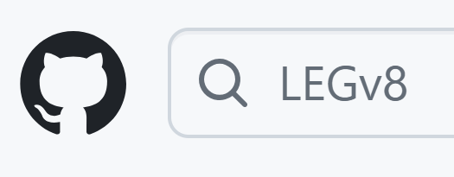
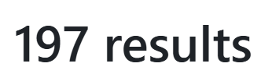
WHAT SIMULATOR, AND WHY?
BUT WHICH ONE?

Slide 40
WHAT SIMULATOR, AND WHY?
THE PROBLEM:
NO SOFTWARE CAN YET SIMULATE THE ENTIRE LEGv8 ISA!

Slide 41
WHAT SIMULATOR, AND WHY?
THE SOLUTION:
Write one from scratch
OR (BETTER)​
Improve one that already exists

Slide 42
WHAT SIMULATOR, AND WHY?
ARM HAS OFFICIALLY MADE A LEGv8 SIMULATOR
GOOD!
IT'S INCOMPLETE AND BROKEN
BAD!

Slide 43
WHAT SIMULATOR, AND WHY?
WHAT STANDS OUT:
Written in Java (high level, extensible)
Distributed as a web application
Nice, functional UI
Closely follows the textbook

Slide 44
FIXING AND RESTORING THE SIMULATOR
STRUCTURE OF THE SIMULATOR
EXECUTION MODE
CODE PARSER/LEXER
INSTRUCTION
CPU
MEMORY

Slide 45
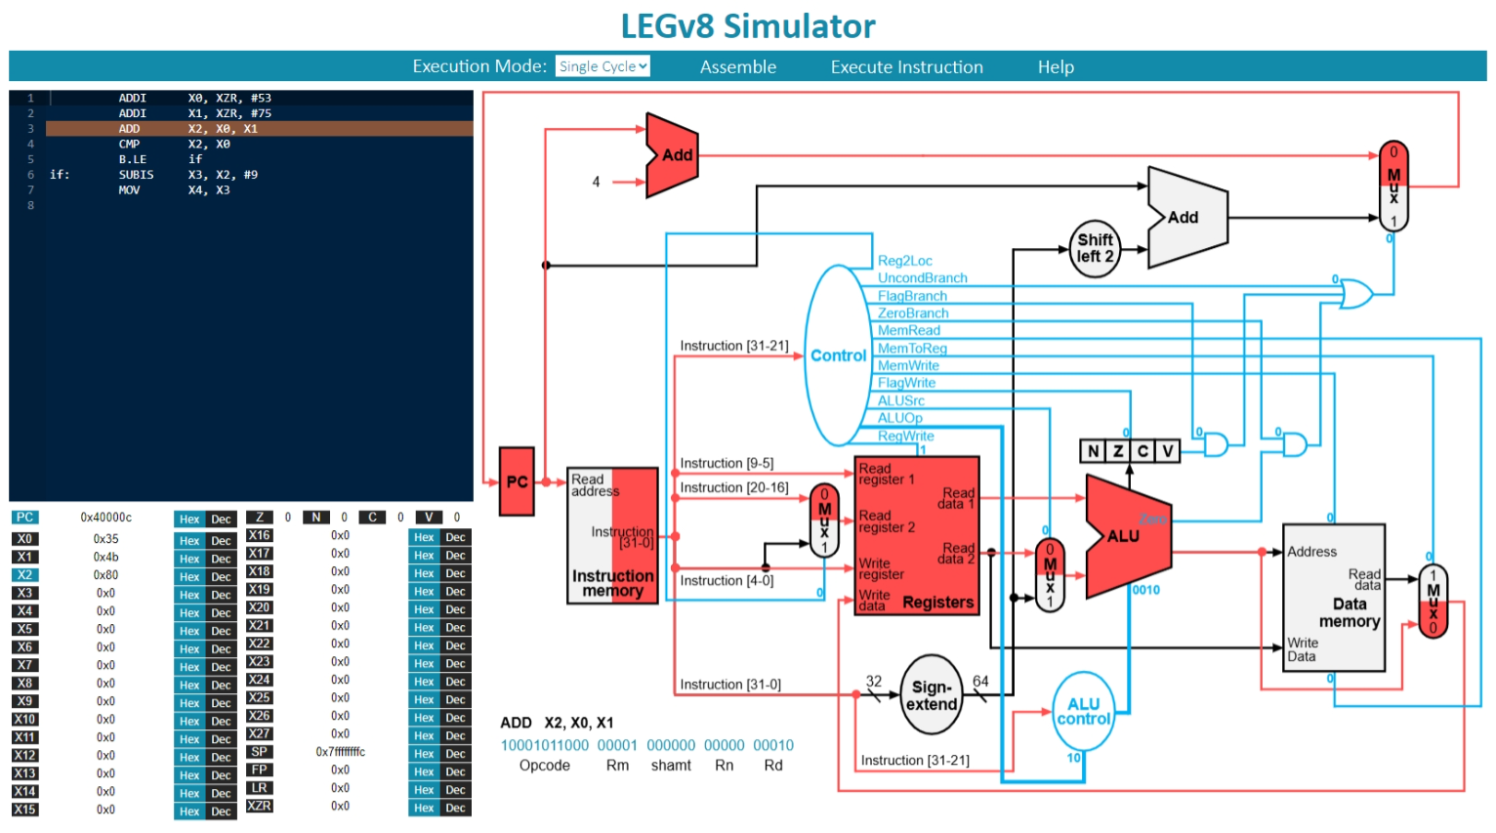
WHAT SIMULATOR, AND WHY?

Slide 46
WHAT SIMULATOR, AND WHY?
WHERE'S THE CATCH?
Integer comparisons are broken
Subroutine calls are broken
Even if fixed: nobody knows how to compile the project!
=> BASICALLY UNUSABLE

Slide 47
FIXING AND RESTORING
THE SIMULATOR
Restoration and development of
Arm's Java-based LEGv8 ISA simulator​

Slide 48
FIXING AND RESTORING THE SIMULATOR
COMPARISONS DON'T WORK!
No "if-else" conditionals
No "switch-case" conditionals
No "while" loops
No "for" loops

Slide 49
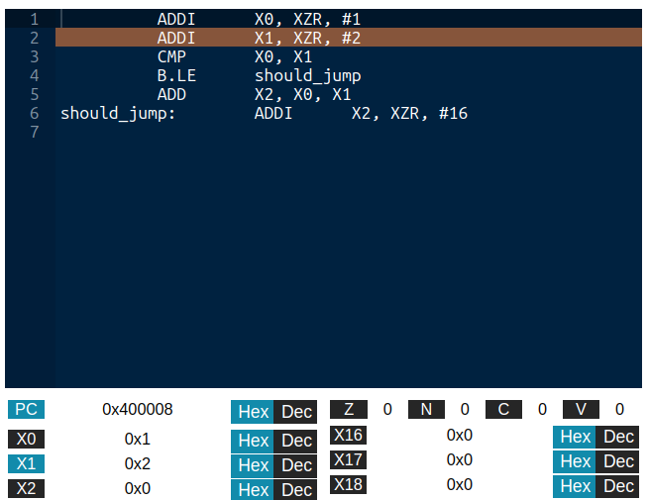
FIXING AND RESTORING THE SIMULATOR
THE COMPARISON BUG
X0 = 1, X1 = 2

Slide 50
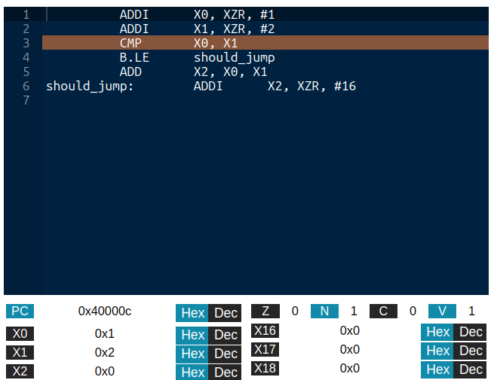
FIXING AND RESTORING THE SIMULATOR
THE COMPARISON BUG
COMPARE X0 WITH X1

Slide 51
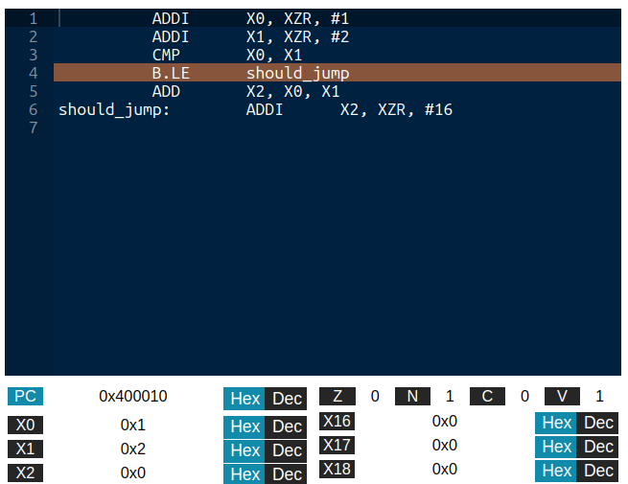
FIXING AND RESTORING THE SIMULATOR
THE COMPARISON BUG
1 <= 2 ?
OF COURSE, LET'S JUMP!

Slide 52
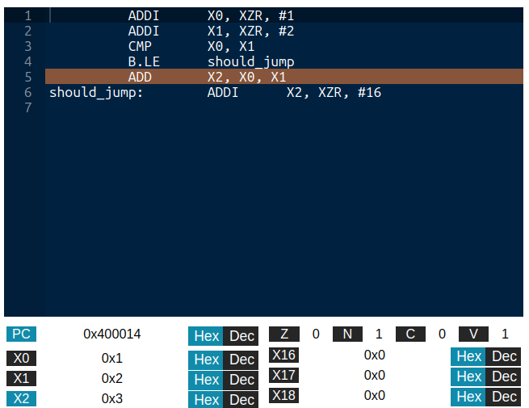
FIXING AND RESTORING THE SIMULATOR
THE COMPARISON BUG
...OR NOT

Slide 53
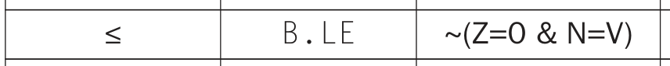
FIXING AND RESTORING THE SIMULATOR
THE FLAGS ARE SET WRONG!
HOW THEY SHOULD BE
HOW THEY ARE
¬(Z=0 ∧ N=V) = ¬(TRUE ∧ TRUE) = FALSE

Slide 54
FIXING AND RESTORING THE SIMULATOR
BRANCH AND LINKS DON'T WORK!
void subroutine(arg1, ...)
float function(arg1, ...)
CAN'T REUSE CODE

Slide 55
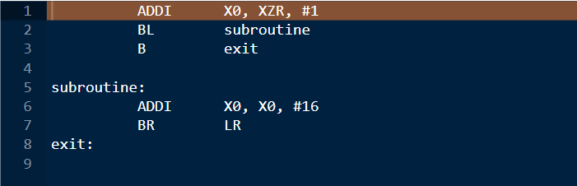
FIXING AND RESTORING THE SIMULATOR
THE BRANCH AND LINK BUG
PROGRAM COUNTER: 0x0
RETURN ADDRESS: 0x0

Slide 56
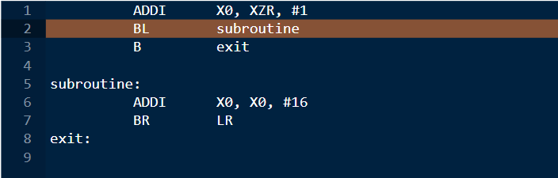
FIXING AND RESTORING THE SIMULATOR
THE BRANCH AND LINK BUG
PROGRAM COUNTER: 0x4
RETURN ADDRESS: 0x0

Slide 57
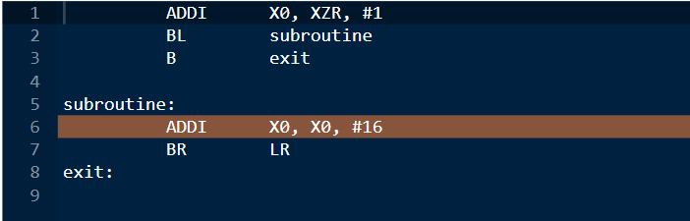
FIXING AND RESTORING THE SIMULATOR
THE BRANCH AND LINK BUG
PROGRAM COUNTER: 0xC
RETURN ADDRESS: 0xC

Slide 58
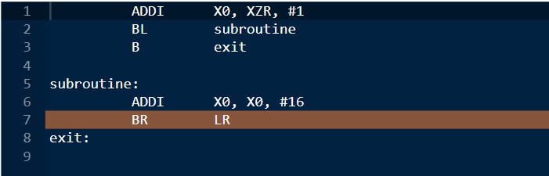
FIXING AND RESTORING THE SIMULATOR
THE BRANCH AND LINK BUG
PROGRAM COUNTER: 0x10
RETURN ADDRESS: 0xC

Slide 59
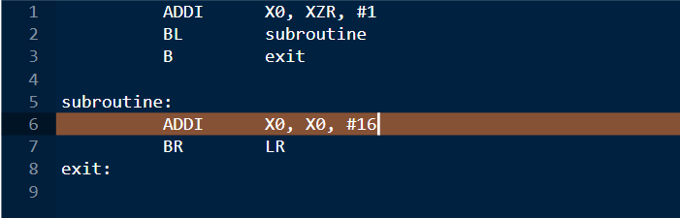
FIXING AND RESTORING THE SIMULATOR
THE BRANCH AND LINK BUG
IT DOESN'T GO BACK!

Slide 60
FIXING AND RESTORING THE SIMULATOR
IT SHOULD GO HERE!
ADDRESS: 0x8
PROGRAM COUNTER: 0xC
RETURN ADDRESS: 0xC

Slide 61
FIXING AND RESTORING THE SIMULATOR
ALL FIXED? NOW WHAT?

Slide 62
FIXING AND RESTORING THE SIMULATOR
THE PROJECT'S LIBRARIES
GWT
AceGWT
THE SIMULATOR

Slide 63
FIXING AND RESTORING THE SIMULATOR
GWT
Framework (formerly) from Google
Generates web applications (client-server, client only) from Java
Emulates Java's JVM with JavaScript

Slide 64
FIXING AND RESTORING THE SIMULATOR
GWT
Old, outdated, barely supported
Convoluted custom build tools
Limited emulation of JVM
Basically needs Eclipse plug-in for real development

Slide 65
FIXING AND RESTORING THE SIMULATOR
AceGWT
Provides GWT bindings for the Ace editor
Can be used like normal GWT component
Also old, outdated, and unsupported

Slide 66
FIXING AND RESTORING THE SIMULATOR
TO BUILD THE PROJECT:
Need old version of Eclipse, and Eclipse GWT plug-in
Reverse engineer the dependencies and where they are needed
Configure the project to stop failing

Slide 67
FILLING THE GAPS
Restoration and development of
Arm's Java-based LEGv8 ISA simulator​

Slide 68
FILLING THE GAPS
WHAT IS THE SIMULATOR MISSING?
Incomplete integer arithmetic
No IEEE-754 arithmetic and data instructions
No visualization for the stack memory

Slide 69
FILLING THE GAPS
THE MISSING INTEGER-BASED INSTRUCTIONS
MUL – LOWER 64 BITS OF THE MULTIPLICATION
SMULH – HIGHER 64 BITS OF THE SIGNED MULTIPLICATION
UMULH – HIGHER 64 BITS OF THE UNSIGNED MULTIPLICATION
SDIV – SIGNED DIVISION
UDIV – UNSIGNED DIVISION
LDA – LOAD ADDRESS OF A LABEL IN A REGISTER

Slide 70
FILLING THE GAPS
UMULH: A CASE STUDY
Takes two 64-bit unsigned integer values
Extends them to 128 bits unsigned
Performs 128-bit product
Saves higher 64 bits to destination

Slide 71
FILLING THE GAPS
PROBLEM 1
Java does not have primitive 128-bit integer types
Product of 64-bit integers truncated
The BigInteger library exists
GWT 2.7 doesn't emulate it (2.8 does)

Slide 72
FILLING THE GAPS
PROBLEM 2
Primitive integers are signed
BigInteger also signed
Bitmask converts 64-bit unsigned integers to 65-bit signed, perform signed multiplication, take the higher bits

Slide 73
FILLING THE GAPS
CAN'T SEE THE STACK
Fundamental for testing and debugging complex programs (now we can write them)
Useful to understanding LEGv8 and stack management
Visible in most simulators

Slide 74
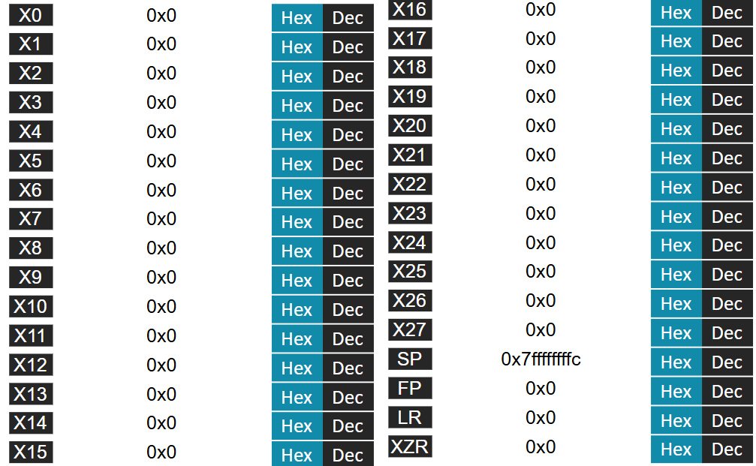
FILLING THE GAPS
THE INTEGER REGISTERS VIEW

Slide 75
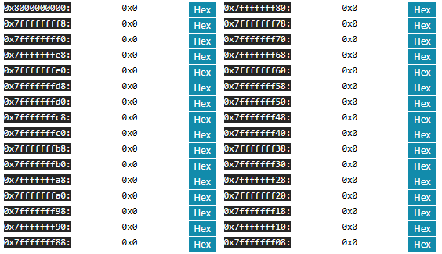
FILLING THE GAPS
THE NEW STACK VIEW

Slide 76
FILLING THE GAPS
ADDING FLOATING-POINT SUPPORT
FADDS, FADDD – ADD TWO IEEE-754 VALUES
FSUBS, FSUBD - SUBTRACT TWO IEEE-754 VALUES
FMULS, FMULD - MULTPLY TWO IEEE-754 VALUES
FDIVS, FDIVD – DIVIDE TWO IEEE-754 VALUES
LDURS, LDURD – LOAD IEEE-754 VALUE FROM MEMORY
STURS, STURD - STORE IEEE-754 VALUE TO MEMORY
FCMPS, FCMPD – COMPARE TWO IEEE-754 VALUES

Slide 77
FILLING THE GAPS
ARITHMETICAL INSTRUCTIONS
(FADDD, FDIVS, …)
Native Java support for IEEE-754 with float and double types
Native Java support for IEEE-754 arithmetical operations
Straight forward implementation

Slide 78
FILLING THE GAPS
MEMORY ACCESS INSTRUCTIONS
(LDURS, STURD, …)
Simulator uses long values to store bits in memory
Use exising longs and ints as raw bits
Use Java Double.longBitsToDouble and Double.doubleToLongBits to convert before memory

Slide 79
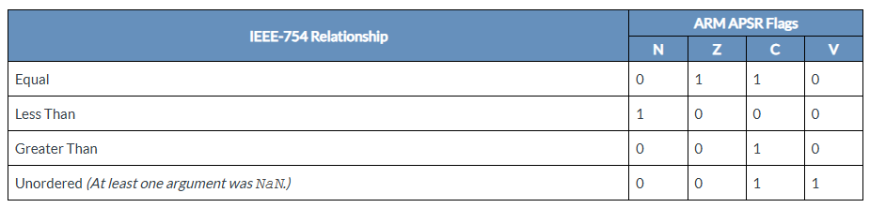
FILLING THE GAPS
COMPARISON INSTRUCTIONS
(FCMPS, FCMPD)
LEGv8 does not specify flag-setting conditions for IEEE-754 comparisons
Use ARMv8's ones

Slide 80
FILLING THE GAPS
INTEGER REGISTERS
FLOATING-POINT REGISTERS

Slide 81
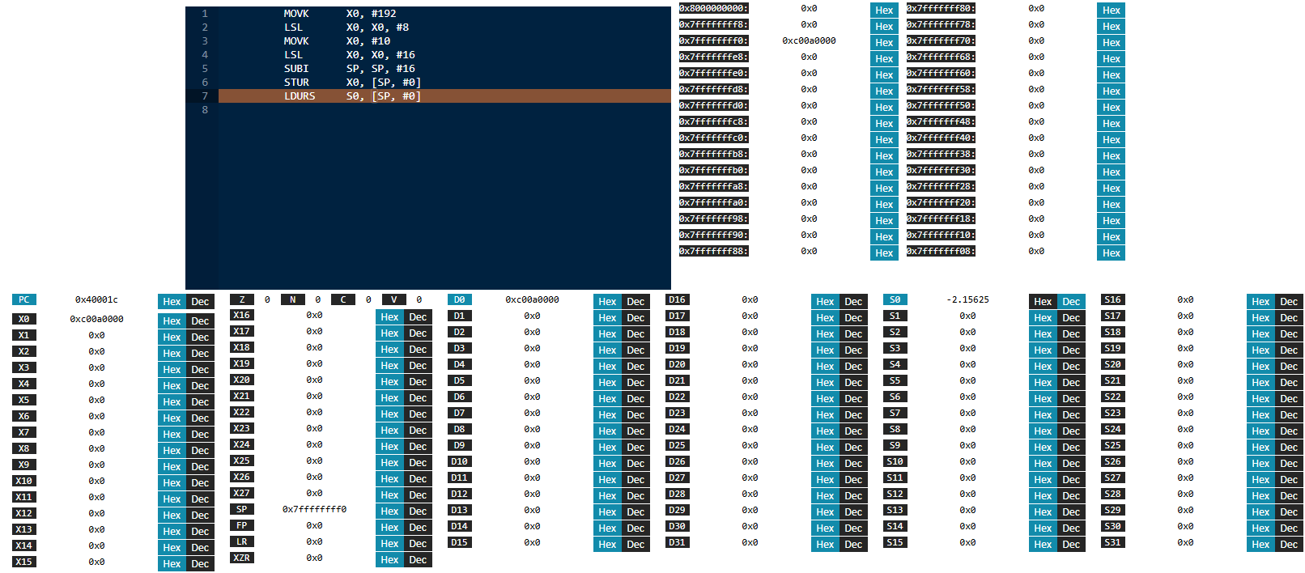
FILLING THE GAPS
THE FINAL VIEW

Slide 82
FILLING THE GAPS
THE CHERRY ON TOP: MODERNIZING THE BUILD SYSTEM
Opens the doors to effortless collaboration
Decouples project from Eclipse IDE
Use updated libraries

Slide 83
FILLING THE GAPS
INTEGRATING MAVEN
Latest GWT and AceGWT support Maven
Integrated Maven into the simulator
Can now use other IDEs, Java 21, GWT 2.11
To develop, download the code and run mvn package. That's it.

Slide 84
CONCLUSIONS
Arm's LEGv8 simulator finally working
Only one to implement every LEGv8 instruction
Can now be developed with modern tools, set-up and build in seconds

Slide 85
SOME FUTURE DEVELOPMENTS
Refactor codebase with modern practices
Improve pipelined execution
Improve UI, make it responsive
Find modern replacements for GWT, AceGWT
Get the changes to the official repos

Slide 86
THANK YOU FOR
YOUR ATTENTION
THESIS AVAILABLE HERE
SIMULATOR AVAILABLE HERE

